Slide 1
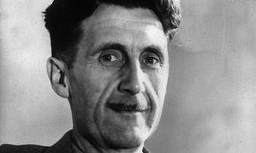
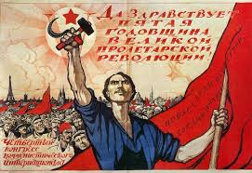
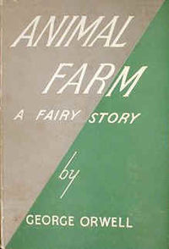
GEORGE ORWELL – ANIMAL FARM
Part 1 – The Life of George Orwell
Part 1
Students read about the life of George Orwell to gain some insight into what motivated him to write the novel Animal Farm.
Part 2
Students read about the history of Russia under the rule of the Tsarist and Communist Regimes.
Part 3
Students read and analyze the novel chapter by chapter with the aid of a variety of graphic organizers and worksheets.
Part 2 – A Short History of Russia
Part 3 – Animal Farm
Along with the worksheets I’ve produced an extensive PowerPoint presentation to help guide students through the material also included in the file.

Slide 2
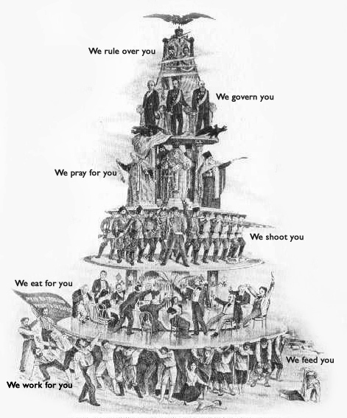
THE RUSSIAN REVOLUTION
By 1900 the nation of Russia had been ruled by the Romanov family for nearly 300 years.
During their rule Russia had been transformed into a huge empire stretching from
Eastern Europe all the way to the Pacific. Romanov rulers, known as Tsars, held almost
total power – a political system known as autocracy.
Russian society under the Romanovs was deeply unequal. At the top of society was the
imperial family along with a large number of nobles who owned huge amounts of land.
Supporting the rule of the Tsars was a large army and powerful church which taught
that God had given the Romanov family the right to rule with almost no limits.
Members of Russia’s upper classes enjoyed lives of extreme luxury and privilege. They
were increasingly being joined by prosperous members of Russia’s growing middle class
of professionals and businessmen many of whom bought titles for themselves and their
families.
At the bottom of Russian society were vast numbers of peasants (known as serfs) and workers. Until the 1860s many of Russia’s peasants had been legally slaves owned and controlled by whoever owned the land they lived on. Over the next 40 years many peasants moved into Russia’s growing cities where they worked and lived in terrible conditions – often earning just enough money to eat the most basic of foods. In many cases families were forced to live in their factories with even young children forced to work.
Growing inequality in Russia, and throughout the industrialized world, caused many writers and thinkers to begin to question the economic system of capitalism. The most influential of these people was Karl Marx (1818 – 1883) who developed a system called Marxism which taught that the history of mankind was dominated by the struggle of a a small ownership class who controlled a nation’s resources and a large laboring class which created wealth but which did not enjoy the fruits of their labor. Marx taught that it was inevitable that the laboring class (the proletariat) would eventually overthrow the ownership class (the bourgeoisie) and create a classless society in which people would not enjoy special privileges simply based on the class they were born into. Such societies would be known as Socialist or Communist societies.

Slide 3
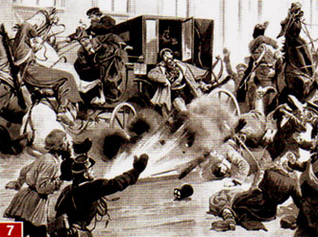
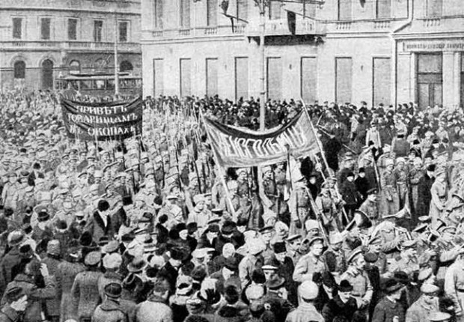
The ideas of Marx, and other Socialists/Communists, spread throughout Europe
between the 1850s and early 1900s. In Russia the government used a secret
police, the Okhrana, to harass and arrest people attempting to form revolutionary
groups. Even people calling for moderate changes, such as the right of people to
vote, were also punished by being sent into exile. Several groups began operating
in secret with some resorting to violence to achieve their goals. In 1881 one such
group, called the People’s Will, succeeded in assassinating Tsar Alexander II.
Government attempts to wipe out these groups often met with failure. By the early
1900s Russia was experiencing a large number of internal difficulties created, in
large part, because of her outdated political and social systems.
In 1905 these political and social problems exploded into a revolution following Russia’s defeat in a war against Japan. A wave of strikes, protest marches, mutinies, and peasant rebellions, spread throughout the country. Protestors demanded reforms and a greater say in Russia’s government. The Tsarist system survived but only after Tsar Nicholas II agreed to reforms. However as soon as order was restored he went back on many of these promises. The Okhrana began arresting more and more suspected revolutionaries while elections to the parliament he set up, the Duma, were rigged in favor of pro-Tsarist political parties. Revolutionary groups responded by committing large numbers of assassinations of government officials, army leaders, and police.
The First World War would ultimately prove to be the fatal blow to the rule of the Romanovs. Although most Russians, even many revolutionary groups, had united behind the Tsar at the start of the war by 1917 this unity had broken down following a series of defeats costing millions of lives. In February of 1917 a series of uprisings sparked by growing food shortages forced Nicholas II to abdicate. Russia then came under the control of a Provisional Government which decided to continue fighting the war at a time when the vast majority of Russians wanted peace, no matter the cost. This government, dominated by members of the middle class, quickly became very unpopular.
One revolutionary group which promised an immediate peace was the Bolshevik Party, led by Vladimir Lenin, who had been born into a noble family but whose brother had been executed by the Romanovs for his revolutionary activities. In February of 1917 Lenin was in exile in Switzerland but, with the assistance of the Germans, he made his way back to

Slide 4
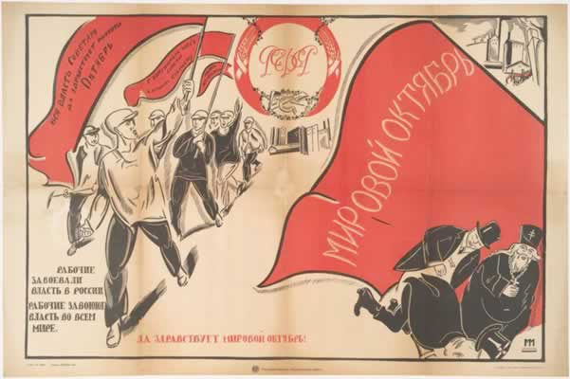
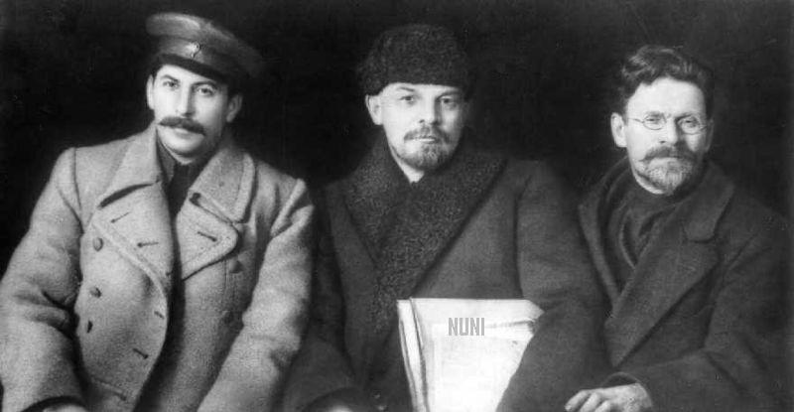
Russia in April. As soon as he arrived he began making fiery speeches in which he promised the Russian people “bread, peace, and land”. In October the Bolsheviks, along with other socialist groups, seized power in the city of Petrograd and overthrew the Provisional government.
Between 1917 and 1922 the Bolsheviks fought a long civil war for
control of Russia against a large number of enemies including
supporters of the old Tsarist regime, non-Bolshevik socialists,
various national groups, and foreign militaries. During this war
Lenin helped to create a new secret police, the Cheka, whose
mission was to eliminate opponents of the new government. All
non-Bolshevik newspapers were closed down while a period
known as the “Red Terror” saw thousands of people arrested and
shot without trial. Amongst those killed were Tsar Nicholas II and
his entire family along with many other Russian nobles or
members of the bourgeoisie.
In 1922, following victory in the Civil War, the Bolsheviks created a union of different Russian states called the USSR. The new Communist government moved to bring industry and agriculture under government control. After Lenin’s death in 1924 the government was dominated by four men, Grigory Zinoviev, Lev Kamenev, Leon Trotsky and Joseph Stalin.
Leon Trotsky had played a major role in the Bolshevik Party since the early 1900s and was a key military leader during the Civil War. Stalin had also played a role in the war however during it he had often come into conflict with Trotsky over military decisions. Stalin was also blamed for several I important defeats. Despite this, by 1922 Stalin had been named the General Secretary of the Communist Party of the Soviet Union – a position which he used to promote his supporters and eliminate his opponents. In particular Stalin and Trotsky disagreed about the future of Communism. Trotsky believed that the Soviet Union should attempt to spread revolution abroad while Stalin believed that the Soviet Union should focus on creating a Communist society in Russia. By 1927 Stalin’s control over the party allowed him and his supporters to expel Trotsky and Zinoviev from their positions and force them into exile.

Slide 5
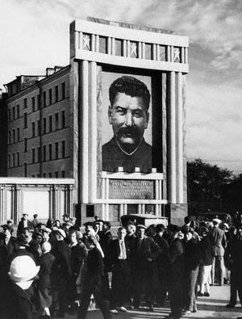
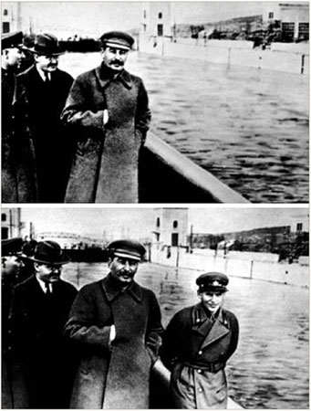
In 1928 Stalin, now the undisputed ruler of the Soviet Union, launched the first of several Five-Year Plans which were designed to rapidly improve Russian industry and agriculture. Targets for production were set by the government while massive works projects were started to build new factories, transportation links, and power plants. Farmland was forcibly taken away from the peasants and was instead organized into large collective farms to which peasants were assigned and from which they could not leave without permission.
The Communist government created a huge propaganda campaign to encourage people
to achieve the goals of the Five-Year Plan. Exceptional workers, known as Stakhanovites,
were praised and rewarded for meeting and exceeding their targets while those who
underperformed were known as “wreckers” and would face severe punishments. The
Soviet Union also used propaganda to create a personality cult around Stalin’s leadership
in which he received constant praise and adulation. Images of Stalin, often altered to hide
his physical imperfections, began appearing throughout the country while newspapers,
movies, and radio shows began referring to him as the “great leader” or “father of all
nations”.
Despite the claims made by Soviet propaganda the early results of the Five-Year plans were not good. Many farmers who resisted having their land taken away were sent to prison camps (known as Gulags) where they and their families were often worked or starved to death. Collectivized farms proved to be very inefficient creating huge food shortages and resulting in the deaths (unreported by Soviet propaganda) of millions of people. Although Russian industry did make progress this was also only achieved at the cost of huge suffering on the part of workers who lacked proper housing, goods, and food. Difficulties or setbacks were often blamed on foreign agents whom it was often claimed were in league with the exiled Leon Trotsky.
In response to these problems Stalin directed a series of bloody purges during the 1930s. His new secret police, the NKVD, arrested nearly 2 million people and executed nearly 700,000 of them. Many others were also sent to the gulags based on little more than the accusations of others who were often under arrest themselves. A series of show trials were held in Moscow during which leading figures of the Communist Party confessed, often after having been tortured, to various crimes including spying for the west or sabotaging Soviet industry and agriculture. Evidence presented at these trials was often fabricated by the NKVD or other groups loyal to Stalin. As leading Communists were

Slide 6
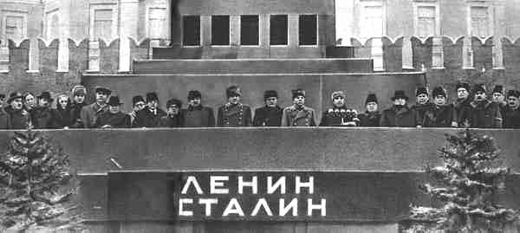
executed, Soviet propaganda often resorted to doctoring pictures or articles to make them “disappear” from the official Soviet history
Communist Party officials who survived Stalin’s purges soon found that
their positions entitled them to many privileges over ordinary Russian
citizens. These officials, known as the Nomenklatura, created a complex
system of alliances with jobs often given to their family members in
return for other favors. While ordinary Russians were forced to live in
crowded apartments with few facilities members of the Nomenklatura
often enjoyed the use of large mansions (known as dachas) which had
formerly belonged to members of the bourgeoisie. Special shops,
schools, and hospitals were created for members of the party elite while
even car lanes were reserved for important officials in Russia’s cities.
By the end of the 1930s Stalin had reversed many of the foreign policy goals of the early Soviet Union. The commitment of Lenin and Trotsky to spread the revolution to other countries had been cancelled. Instead the Soviet Union began normalizing diplomatic relations with many capitalist western nations with whom it began trading. During that decade many western writers and journalists had travelled to the USSR where, deceived by Soviet propaganda or their own willingness to turn a blind eye, they reported favorably on life there to their readers in the United States and Western Europe.
In 1939 Stalin surprised the world by making an alliance with Hitler’s Nazi Germany which had, since 1933, been one of the USSR’s most public enemies. Indeed in his writings Hitler had long promised to destroy Communism and conquer most of Russia. For the next two years Stalin arranged for supplies of fuel and other materials to be sent to Nazi Germany however in June of 1941 Hitler launched a surprise attack against the USSR which, thanks to Stalin’s incompetent leadership, succeeded in conquering huge amounts of territory and kill millions of Russians. Stalin then entered into another alliance with the United States and United Kingdom in exchange for his dissolving of the Comintern organization which had worked to spread Communism into western nations. Although the Soviet Union eventually defeated the Nazis they only did so at the cost of over 20 million dead and large parts of the country, including many of the achievements of the Five-Year Plans, being destroyed.

Slide 7
As you read through the information about Russia under the Tsars and Communists answer the following questions.
1) Which groups held privileged positions in Russian society during the 1800s and early 1900s?
_____________________________________________________________________________________________________________________________________________________________________________________________________________
2) Why was life hard for Russia’s poor?
______________________________________________________________________________________________________________________________________________________________________________________________________________________________________________________
3) What conflict did Karl Marx say had dominated the history of mankind?
_____________________________________________________________________________________________________________________________________________________________________________________________________________
4) What type of society did Marx predict would be created in the future?
_____________________________________________________________________________________________________________________________________________________________________________________________________________
5) Who were the Okhrana ?
______________________________________________________________________________________________________________________________________________________________________________________________________________________________________________________
6) What led to the revolutions of 1905 and of February 1917?
_____________________________________________________________________________________________________________________________________________________________________________________________________________

Slide 8
7) What promises were made by the Bolshevik Party and Vladimir Lenin?
_____________________________________________________________________________________________________________________________________________________________________________________________________________
8) What was the “Red Terror”?
______________________________________________________________________________________________________________________________________________________________________________________________________________________________________________________
9) What roles did Trotsky and Stalin play during the Civil War?
_______________________________________________________________________________________________________________________________________________________________________________________________________________________________________________________________________________________________
10) How was Stalin able to take control of the Communist Party?
_____________________________________________________________________________________________________________________________________________________________________________________________________________
11) What major disagreement did Trotsky and Stalin have over the future of Communism?
______________________________________________________________________________________________________________________________________________________________________________________________________________________________________________________
12) What were the Five-Year Plans?
_______________________________________________________________________________________________________________________________________________________________________________________________________________________________________________________________________________________________

Slide 9
13) Who were the Stakhanovites?
_____________________________________________________________________________________________________________________________________________________________________________________________________________
14) In what ways was a personality cult built around Stalin?
________________________________________________________________________________________________________________________________________________________________________________________________________________________________________________________________________________________________________________________________________
15) What were the gulags?
_______________________________________________________________________________________________________________________________________________________________________________________________________________________________________________________________________________________________
16) How did the Communist government attempt to explain failures or difficulties?
_____________________________________________________________________________________________________________________________________________________________________________________________________________
17) What were the purges?
________________________________________________________________________________________________________________________________________________________________________________________________________________________________________________________________________________________________________________________________________
18) What was the role of the NKVD?
_______________________________________________________________________________________________________________________________________________________________________________________________________________________________________________________________________________________________

Slide 10
19) Who were the Nomenklatura?
_____________________________________________________________________________________________________________________________________________________________________________________________________________
20) What privileges did the Nomenklatura have?
________________________________________________________________________________________________________________________________________________________________________________________________________________________________________________________________________________________________________________________________________
21) How did Stalin change Soviet foreign policy?
________________________________________________________________________________________________________________________________________________________________________________________________________________________________________________________________________________________________________________________________________
22) Why was the alliance with Nazi Germany surprising?
____________________________________________________________________________________________________________________________________________________________________
23) What compromise did Stalin make as he allied with Britain and the United States?
____________________________________________________________________________________________________________________________________________________________________
FINAL QUESTION
1) In what ways, and for what reasons, did Russia under the rule of the Communists come to resemble Russia under the rule of the Tsars?
Use the graphic organizer on the next page to help you compare and contrast Russia under the two governments.

