Slide 1
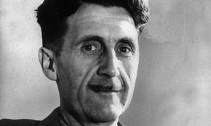
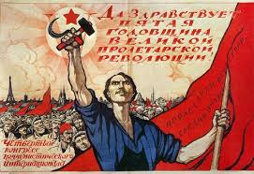
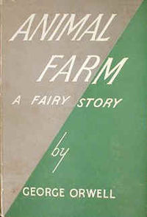
GEORGE ORWELL – ANIMAL FARM
Part 1 – The Life of George Orwell
Part 1
Students read about the life of George Orwell to gain some insight into what motivated him to write the novel Animal Farm.
Part 2
Students read about the history of Russia under the rule of the Tsarist and Communist Regimes.
Part 3
Students read and analyze the novel chapter by chapter with the aid of a variety of graphic organizers and worksheets.
Part 2 – A Short History of Russia
Part 3 – Animal Farm
Along with the worksheets I’ve produced an extensive PowerPoint presentation to help guide students through the material also included in the file.

Slide 2
Free Write
5 Minutes
Write a description of your perfect high school. Consider what the building(s) would look like, the bell schedule, the classes offered, the length of classes, grading procedures, electives, lunch, clubs, sports, etc.
In this high school, everyone is equal.

Slide 3
Share out
Are our ideas similar or different?

Slide 4
Utopia
“A place of ideal perfection especially in laws, government and social conditions” – Merrian Webster Dictionary
Can a world like this exist?

Slide 5
Dystopia
“an imaginary place where people lead dehumanized and often fearful lives” – Merriam Webster Dictionary
Dehumanize – “to deprive of human qualities, personality, or spirit” – Merriam Webster Dictionary

Slide 6
Animal Farm by George Orwell
Animal Farm is a dystopian novel. It will follow the animals on Manor Farm through their journey to take it over.

Slide 7
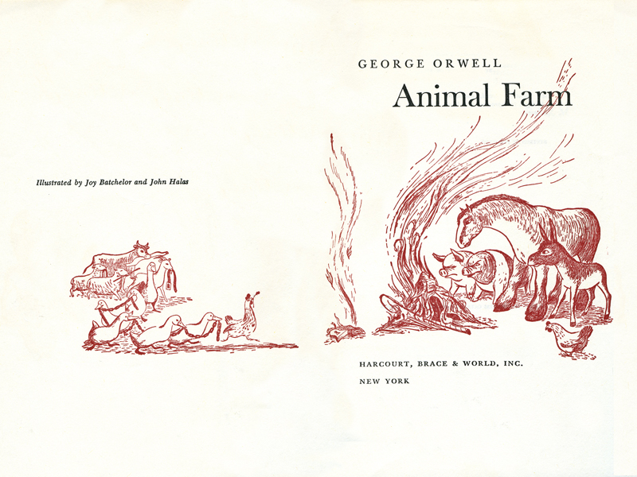
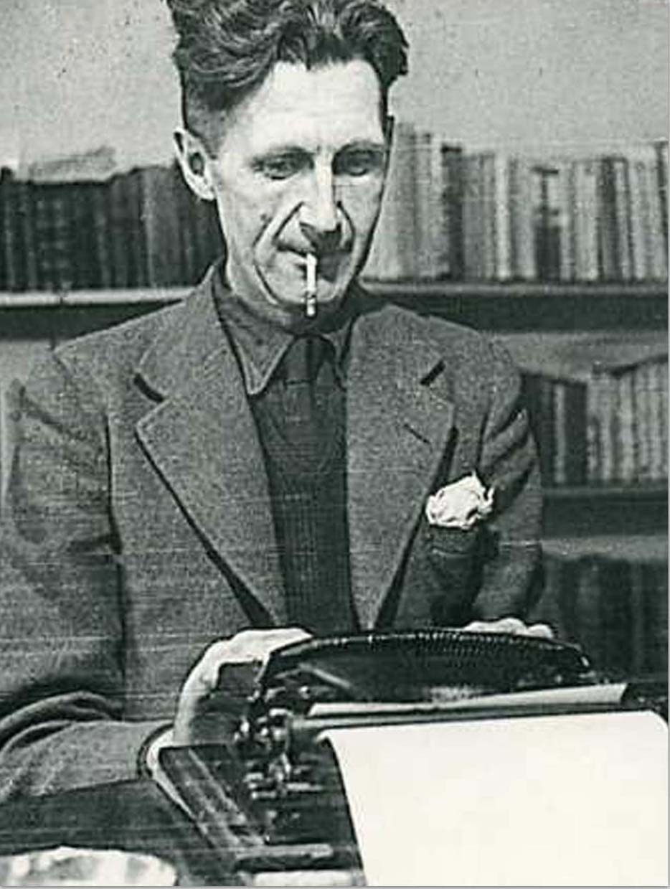
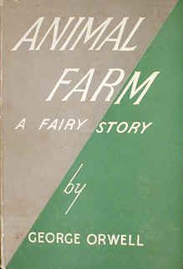
GEORGE ORWELL
George Orwell, real name Eric Arthur Blair, was born in India in 1903 where his father worked for the Indian Civil Service. He was educated at one of the most prestigious schools in England, Eton, and then joined the Indian Imperial Police in the colony of Burma.
In 1927 Orwell returned to England with the goal of becoming a professional writer. He began investigating the lives of the poor in both London and Paris resulting in his first book - Down and Out in Paris and London - which was published in 1933. In 1936 he published another book – The Road to Wigan Pier – which explored the suffering of ordinary people during the Great Depression.
In December of 1936 Orwell travelled to Spain where he intended to report on the Civil War between the Fascist Nationalists of General Franco and the Communist/Socialist Republican government. In Spain Orwell witnessed the bitter infighting between Communist forces loyal to Trotsky and those loyal to Stalin and the Soviet Union. Many volunteers, including Orwell, were accused by Stalinist forces of being secretly in league with the Fascists. Although Orwell managed to escape many others were executed.
During World War Two Orwell worked for the British government producing propaganda. The war saw a huge rise in the popularity of Stalin’s Soviet Union which was portrayed as being engaged in a heroic struggle against Fascism. Many people in Western Europe joined Communist Parties which were directly or indirectly controlled by the Soviet Union. Alarmed at this Orwell wrote and published Animal Farm as a warning against the type of Communism practiced by Stalin.
After the war Orwell was increasingly in a state of poor health. In 1949 he published his last major work – 1984 – which warned about the dangers of totalitarian states and how they could manipulate and control the people.

Slide 8
1. Why might George Orwell not have had much knowledge about the lives of ordinary people as a young boy and young man?
____________________________________________________________________________________________________________________________________________________________________________________________________________________________________
2. In what ways do you think a person could gain more knowledge about the lives of poor people?
____________________________________________________________________________________________________________________________________________________________________________________________________________________________________
____________________________________________________________________________
3. Why, according to the text, did Orwell become opposed to Stalinism?
____________________________________________________________________________________________________________________________________________________________________________________________________________________________________
4. Why did Orwell decide to write Animal Farm?
____________________________________________________________________________________________________________________________________________________________________________________________________________________________________

