Slide 1
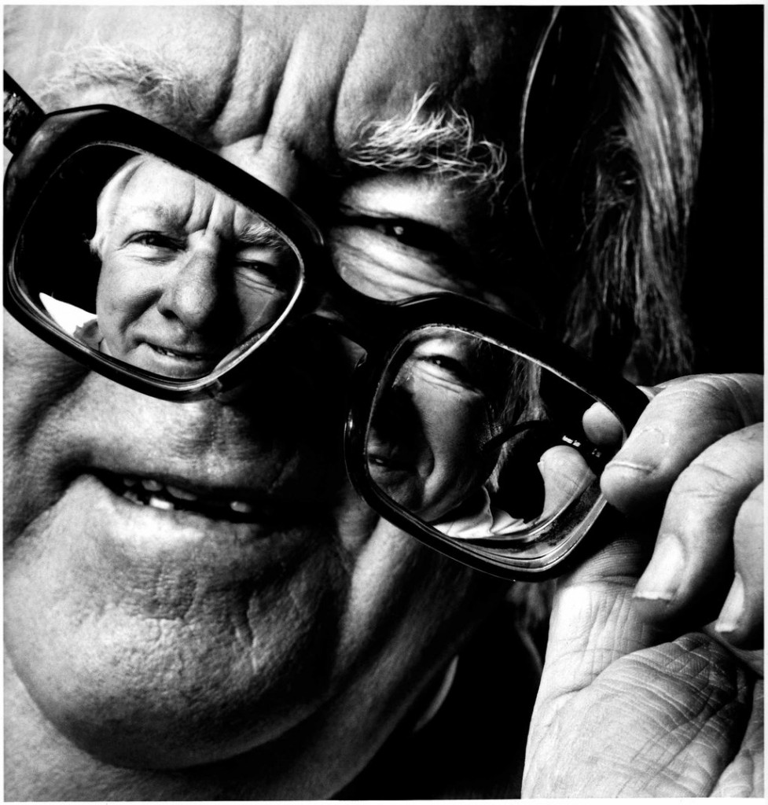
Ray Bradbury.
Novelist
Short Story Writer
Essayist
Playwright
Screenwriter
Poet

Slide 2
Ray Bradbury
“I decided . . . that I wanted to grow up to become a magician. That's just about what happened, isn't it? People call me a science fiction writer, but I don't think that's quite true. I think that I'm a magician who is capable of making things appear and disappear right in front of you and you don't know how it happened.”

Slide 3
Mr. Electrico
http://electrico

Slide 4
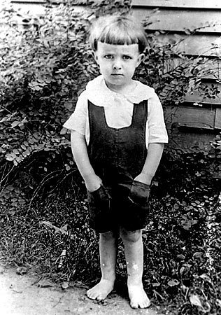
Early Life
Born August 22, 1920 in Waukegan, Illinois.
As a child, he was a huge fan of magicians and a voracious reader of adventure and fantasy fiction—especially L. Frank Baum, Jules Verne and Edgar Rice Burroughs.
He decided to become a writer at age 12.
After graduating from high school in 1938, Bradbury couldn't afford to go to college, so he went to the local library instead.
"Libraries raised me," he said. "When I graduated from high school, it was during the Depression, and we had no money. I couldn't go to college, so I went to the library three days a week for 10 years."
Notes:
Jules Verne- Journey to the Center of the Earth, Twenty-Thousand Leagues Under the Sea, Around the World in Eighty Days
Frank Baum- Wizard of Oz
Edgar Ride Burroughs- Princess of Mars, Tarzan, The Land that Time Forgot

Slide 5
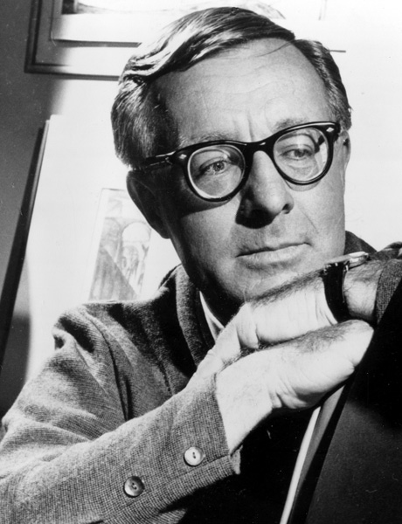
Career
To support himself while he wrote, Bradbury sold newspapers.
He published his first short story in a fan magazine in 1938, the same year he graduated from high school.
Bradbury sold his first professional piece, the story "Pendulum," in November 1941, just a month before the United States entered World War II.
Bradbury became a full-time writer by early 1943.
His first collection of short stories, Dark Carnival, was published in 1947.

Slide 6
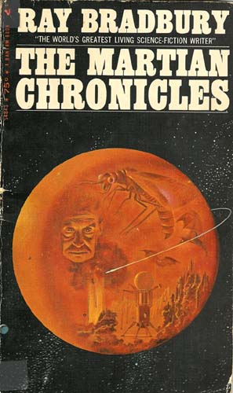
Career
In 1950, Bradbury published his first major work, The Martian Chronicles, which detailed the conflict between humans colonizing the red planet and the native Martians they encountered there.
While taken by many to be a work of science fiction, Bradbury himself considered it to be fantasy.
"I don't write science fiction," he said. "Science fiction is a depiction of the real. Fantasy is a depiction of the unreal. So Martian Chronicles is not science fiction, it's fantasy. It couldn't happen, you see?"
In 1953 he published his best-known work, Fahrenheit 451.
In all, Bradbury published more than thirty books, close to 600 short stories, and numerous poems, essays, and plays.
Ray Bradbury died: June 5, 2012.
He was 91.

Slide 7
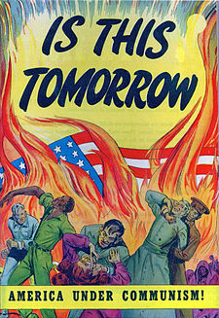
McCarthyism
During the late 1940s and early 1950s, the prospect of communist subversion at home and abroad seemed frighteningly real to many people in the United States.
These fears came to define–and, in some cases, corrode–the era’s political culture. For many Americans, the most enduring symbol of this “Red Scare” was Republican Senator Joseph P. McCarthy of Wisconsin.
Senator McCarthy spent almost five years trying in vain to expose communists and other left-wing “loyalty risks” in the U.S. government. In the hyper-suspicious atmosphere of the Cold War, insinuations of disloyalty were enough to convince many Americans that their government was packed with traitors and spies.
McCarthy’s accusations were so intimidating that few people dared to speak out against him. It was not until he attacked the Army in 1954 that his actions earned him the censure of the U.S. Senate.

Slide 8
Fahrenheit 451
In 1951 Bradbury wrote a novella, “The Fireman” (based on the premise of his short story “Bright Phoenix”) to be published in Galaxy Magazine.
In 1953 Bradbury expanded “The Fireman” into Fahrenheit 451, one which many consider to be his masterpiece.
451 is a scathing indictment of censorship set in a future world where the written word is forbidden.
The book burnings during World War II deeply angered Bradbury, a core inspiration for this novel.
451 became an instant classic in the era of McCarthyism for its exploration of themes of censorship and conformity.

Slide 9
Bradbury on writing, learning, and F451.
conversation with ray bradbury

Slide 10
Sources
www.raybradbury.com
www.biography.com
www.history.com

