Slide 1
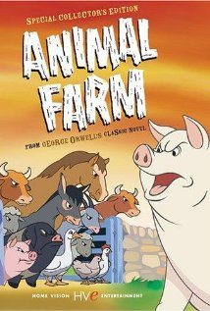
ANIMAL FARM - 1954
https://www.youtube.com/watch?v=DsU3CdQdhWs
Produced during the beginning stages of the Cold War, this version of Animal Farm was funded by the Central Intelligence Agency (C.I.A.) which wanted anti-Communist propaganda which could be used against the Soviet Union.
As you watch the movie look at the worksheet and identify any differences you notice between it and the book as it was written by Orwell.
Movie Notes

Slide 2
DIFFERENCES IN CHARACTERS
DIFFERENCES IN THE PLOT

