Slide 1
Animal Farm
Chapter 9 Review

Slide 2
http://prezi.com/l_havieif3xg/euphenisms/?kw=view-l_havieif3xg&rc=ref-11956895

Slide 3
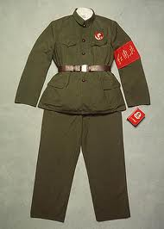
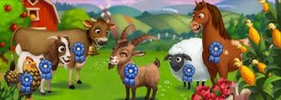
What euphemism is used to convince the animals that they were not really receiving less food than they had under jones?
Squealer talks about of "readjustment", and not of what is really happening, which is a reduction of the food.
Do you wear an item to show that you belong to a certain group?
Represent

Slide 4
Russia becoming the USSR.
What does Animal Farm changing to a republic stand for?
The Soviet Union was founded in 1924, seven years after the Russian Revolution overthrew the monarchy of the czar, and was dissolved in late 1991.
State Emblem
Flag

Slide 5
What propaganda was told to the animals after Boxer’s death?
Boxer’s strength fails and he collapses while pulling stone for the windmill.
The other animals rush to tell Squealer, while Benjamin and Clover stay near their friend.
The animals panic and begin crying out to Boxer that he must escape.
Soon Squealer announces that the doctors could not cure Boxer: he has died at the hospital.
The animals heave a sigh of relief at this news, and when Napoleon gives a great speech in praise of Boxer, they feel completely soothed.
Although, Napoleon actually sold Boxer to the glue maker; he sold him for money to buy more whiskey.

