Slide 1
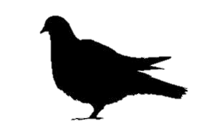
9
ANIMAL FARM – CHAPTER 9
1. What had been agreed about Boxer’s retirement ? _________________________________
________________________________________________________________________________________________________________________________________________________________________________________________________________________________________________________________________________________________________________
2. Why did the animals believe Squealer’s claims about how much better the farm was doing than in Jones’ day ? ____________________________________________________________
________________________________________________________________________________________________________________________________________________________________________________________________________________________________________________________________________________________________________________
3. What new privileges did the pigs now enjoy over the other animals ? __________________
____________________________________________________________________________________________________________________________________________________________________________________________________________________________________
________________________________________________________________________________________________________________________________________________________________________________________________________________________________________________________________________________________________________________

Slide 2
4. How did the pigs attempt to distract the animals from their true living conditions ? ______
____________________________________________________________________________
________________________________________________________________________________________________________________________________________________________________________________________________________________________________________________________________________________________________________________
5. How were Snowball’s actions during the Battle of the Cowshed changed even further? ____
________________________________________________________________________________________________________________________________________________________________________________________________________________________________________________________________________________________________________________
6. How was Boxer finally betrayed by Napoleon and the other pigs ? ____________________
____________________________________________________________________________________________________________________________________________________________________________________________________________________________________
________________________________________________________________________________________________________________________________________________________
7. What lie did Squealer tell the other animals about Boxer’s death? _____________________
____________________________________________________________________________________________________________________________________________________________________________________________________________________________________

