Slide 1
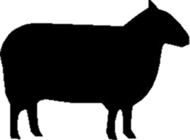
4
ANIMAL FARM – CHAPTER 4
1. Why was Jones initially unable to get help to retake his farm ? _______________________
________________________________________________________________________________________________________________________________________________________________________________________________________________________________________________________________________________________________________________________________________________________________________________________________________________________________________________________________________
2. What impact did the rebellion at Animal Farm have on other farms and animals ? ________
____________________________________________________________________________________________________________________________________________________________________________________________________________________________________
________________________________________________________________________________________________________________________________________________________
3. How did other farmers react to what had happened at Animal Farm ? _________________
________________________________________________________________________________________________________________________________________________________
____________________________________________________________________________________________________________________________________________________________________________________________________________________________________

Slide 2
4. What role did Snowball play in the defense of Animal Farm ? ____________________________________________________________________________________________________________________________________________________________________________________________________________________________________________________________________________________________________________________________________________________________________________________________
5. How did the animals recognize the importance of the Battle of the Cowshed? ___________
____________________________________________________________________________________________________________________________________________________________________________________________________________________________________
____________________________________________________________________________
"No sentimentality, comrade!" cried Snowball from whose wounds the blood was still dripping. "War is war. The only good human being is a dead one.”
How does this quote reveal the differences between the personalities of Boxer and Snowball? _________________________________________________________________
____________________________________________________________________________________________________________________________________________________________________________________________________________________________________________________________________________________________________________________________________________________________________________________________________________________________________________________________

