Slide 1
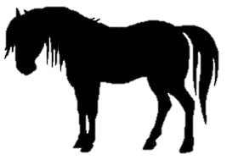
3
ANIMAL FARM – CHAPTER 3
1. Why were the animals initially successful in their efforts to bring in the harvest __________
________________________________________________________________________________________________________________________________________________________________________________________________________________________________________________________________________________________________________________________________________________________________________________________________________________________________________________________________________
2. In what ways did Boxer attempt to set an example for the other animals? ______________
____________________________________________________________________________________________________________________________________________________________________________________________________________________________________
________________________________________________________________________________________________________________________________________________________
3. In what ways had life for the animals improved? __________________________________
________________________________________________________________________________________________________________________________________________________
____________________________________________________________________________________________________________________________________________________________________________________________________________________________________

Slide 2
4. In what different ways had the pigs begun to take charge of the farm? ____________________________________________________________________________________________________________________________________________________________________________________________________________________________________________________________________________________________________________________________________________________________________________________________
6. How do the pigs justify their taking of the milk and apples? __________________________
____________________________________________________________________________________________________________________________________________________________________________________________________________________________________
________________________________________________________________________________________________________________________________________________________
“When they had once got it by heart, the sheep developed a great liking for this maxim, and often as they lay in the field they would all start bleating "Four legs good, two legs bad! Four legs good, two legs bad!" and keep it up for hours on end, never growing tired of it..”
What do you think Orwell is arguing here about many supporters of revolutions? ______
__________________________________________________________________________________________________________________________________________________________________________________________________________________________________________________________________________________________________________________________________________________________________________________

