Slide 1
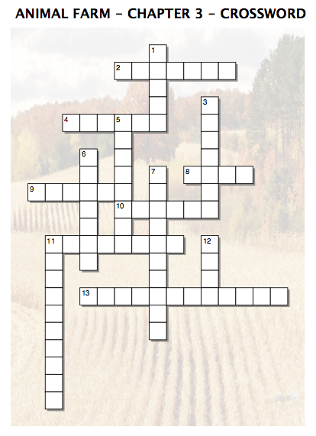
Across
2. Four legs _______, two legs _______ - Animal Farm motto.
4. What the green in the animals' flag represented.
8. Drink reserved for the pigs only.
9. I will work ____________ - Boxer's motto.
10. Food reserved for the pigs only.
11. The animal which woke Boxer up early.
13. How the pigs described their role.
Down
1. Person whom the pigs used to strike fear into the other animals.
3. What Napoleon took away from their mothers.
5. The ability to read and write.
6. The area of land set aside for retired animals.
7. Another word for tools.
11. What Snowball organized the animals into.
12. The most letters Boxer could memorize.

