Slide 1
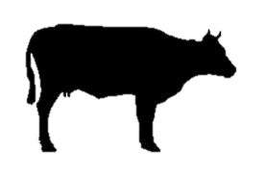
2
ANIMAL FARM – CHAPTER 2
1. What characters are Snowball and Napoleon described as having ? ___________________
________________________________________________________________________________________________________________________________________________________________________________________________________________________________________________________________________________________________________________
2. What reasons did the other animals give for resisting the idea of rebelling? _____________
____________________________________________________________________________________________________________________________________________________________________________________________________________________________________
____________________________________________________________________________________________________________________________________________________________________________________________________________________________________
3. What group in Tsarist Russia is Moses the Raven portraying ? ________________________
________________________________________________________________________________________________________________________________________________________
4. In what ways does Mr. Jones neglect his farm? ____________________________________
________________________________________________________________________________________________________________________________________________________

Slide 2
5. What immediate steps did the animals take once Jones and his men had been expelled? ____________________________________________________________________________________________________________________________________________________________________________________________________________________________________________________________________________________________________________________________________________________________________________________________
6. In what ways did the pigs begin to take command of the farm? _______________________
____________________________________________________________________________________________________________________________________________________________________________________________________________________________________
________________________________________________________________________________________________________________________________________________________
"Never mind the milk, comrades!" cried Napoleon, placing himself in front of the buckets. "That will be attended to. The harvest is more important. Comrade Snowball will lead the way. I shall follow in a few minutes. Forward, comrades! The hay is waiting.” So the animals trooped down to the hayfield to begin the harvest, and when they came back in the evening it was noticed that the milk had disappeared.
What is inferred from this passage about Napoleon? _______________________________
______________________________________________________________________________________________________________________________________________________________________________________________________________________________

