Slide 1
Whatever goes up on 4 legs , or has wings is a friend
No animal shall wear clothes
Whatever goes up on 2 legs is an enemy
7 Commandments
FOR THE ANIMALS
No animal shall sleep in a bed
No animal shall drink alcohol
No animal shall kill any other animal
All animals are equal

Slide 2
7 Commandments
How well do these commandments reflect Old Major’s vision for the farm?
So far, is the farm aligned with Old Major’s dream?
How does this show the animals respected him and his dream?

Slide 3
7 COMMANDMENTS FOR OUR CLASSROOM –
that would make school better for everyone. (An education must still be provided)

Slide 4
Read the quotes from the text and attempt to work out the meaning from the context of the sentence. Then look up synonyms using a thesaurus.
QUOTE
GUESSED MEANING
SYNONYMS
PART OF SPEECH
Snowball was a more vivacious pig than Napoleon, quicker in speech and more inventive, but was not considered to have the same depth of character.
Adjective Noun
Verb Adverb
Several nights a week, after Mr. Jones was asleep, they held secret meetings in the barn and expounded the principles of Animalism to the others.
Adjective Noun
Verb Adverb
The reins, the halters, the blinkers, the degrading nosebags, were thrown on to the rubbish fire which was burning in the yard
Adjective Noun
Verb Adverb
In the ecstasy of that thought they gamboled round and round, they hurled themselves into the air in great leaps of excitement.
Adjective Noun
Verb Adverb
She had taken a piece of blue ribbon from Mrs. Jones's dressing-table, and was holding it against her shoulder and admiring herself in the glass in a very foolish manner. The others reproached her sharply, and they went outside.
Adjective Noun
Verb Adverb

Slide 5
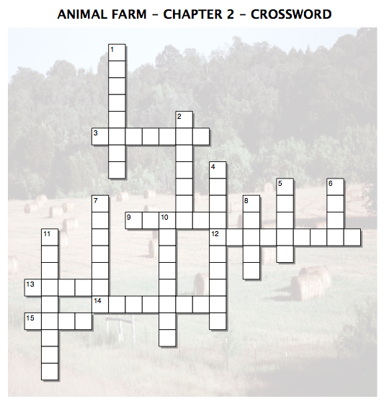
Across
3. Jones' favorite public house.
9. What Jones' house was turned into.
12. The set of ideas based around Old Major's teachings.
13. Number of times that Beasts of England was sung.
14. The best talker among the pigs.
15. What Napoleon is inferred as drinking.
Down
1. One of the leading pigs
2. What the animals called each other.
4. The new name for Manor Farm.
5. Mollie's biggest concern.
6. the smartest of the animals.
7. Items thrown onto the fire by Snowball.
8. An item thrown on the fire.
10. One of the leading pigs.
11. An item thrown down the well.

Slide 6
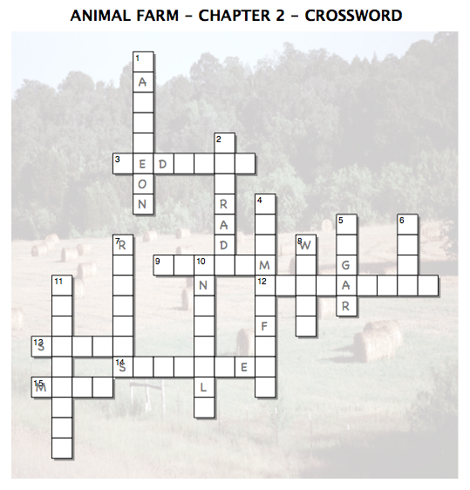
Across
3. Jones' favorite public house.
9. What Jones' house was turned into.
12. The set of ideas based around Old Major's teachings.
13. Number of times that Beasts of England was sung.
14. The best talker among the pigs.
15. What Napoleon is inferred as drinking.
Down
1. One of the leading pigs
2. What the animals called each other.
4. The new name for Manor Farm.
5. Mollie's biggest concern.
6. the smartest of the animals.
7. Items thrown onto the fire by Snowball.
8. An item thrown on the fire.
10. One of the leading pigs.
11. An item thrown down the well.

