Slide 1
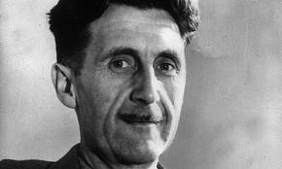
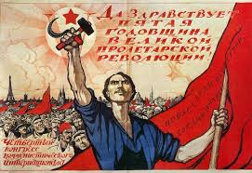
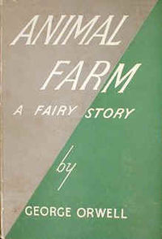
GEORGE ORWELL – ANIMAL FARM
Part 1 – The Life of George Orwell
Part 1
Students read about the life of George Orwell to gain some insight into what motivated him to write the novel Animal Farm.
Part 2
Students read about the history of Russia under the rule of the Tsarist and Communist Regimes.
Part 3
Students read and analyze the novel chapter by chapter with the aid of a variety of graphic organizers and worksheets.
Part 2 – A Short History of Russia
Part 3 – Animal Farm
Along with the worksheets I’ve produced an extensive PowerPoint presentation to help guide students through the material also included in the file.

Slide 2
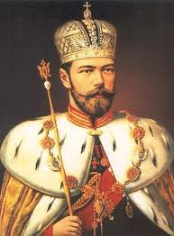
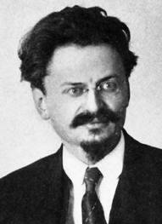
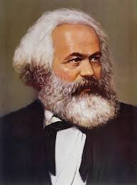
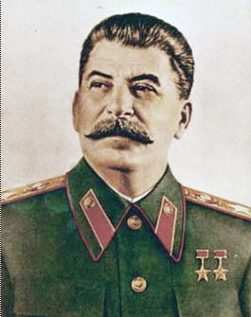
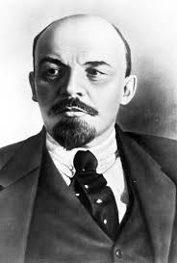
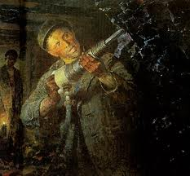
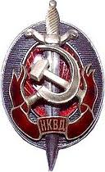
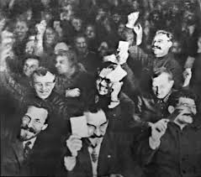
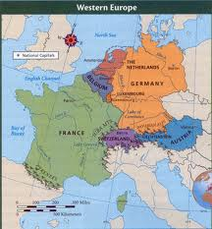
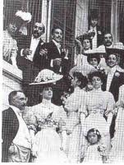
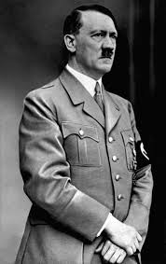
As you read through Animal Farm identify which characters are based on the people or organizations below
Nicholas II
Leon Trotsky
Karl Marx
Joseph Stalin
Vladimir Lenin
Stakhanovites
The Cheka / NKVD
Soviet Propaganda Ministry
The Nomenklatura
Western Nations
The Bourgeoisie
Adolf Hitler

Slide 3
As you read the book complete the chart below to show the parallels between the history of Russia and the story of Animal Farm.
HISTORICAL EVENTS
ANIMAL FARM
Russia exists under the oppressive rule of the Romanovs
Karl Marx publishes the Communist Manifesto
Ordinary Russians struggle due to war and shortages of food
The Russians overthrow the Tsar and the Provisional Government.
Symbols of the old government are destroyed.
The government takes steps to improve education.

Slide 4
HISTORICAL EVENTS
ANIMAL FARM
Foreign nations and other forces try to overthrow the Communists.
Trotsky and Stalin take over from Lenin’s leadership.
The Communists bring industry and farming under their control.
Trotsky and Stalin disagree over the future of Communism.
Stalin takes control of the Communist party
Trotsky is expelled from the Communist Party and exiled.
Stalin introduces the Five-Year Plans

Slide 5
HISTORICAL EVENTS
ANIMAL FARM
Opponents of Stalin are purged by the NKVD.
Show trials are held based on forced confessions.
Problems or difficulties are blamed on Trotsky.
Ordinary Russians suffer from shortages of food and other items.
Members of the Nomenklatura gain special privileges.
Communist propaganda begins to rewrite history.
Stalin builds trade relationships with western nations.

Slide 6
HISTORICAL EVENTS
ANIMAL FARM
Stalin makes an alliance with Adolf Hitler’s Nazi Germany
The Soviet Union is invaded by Germany
Stalin makes new alliances with the USA and U.K.
Stalin dissolves the Comintern

Slide 7
1
ANIMAL FARM – CHAPTER 1
1. In what ways is Jones the farmer shown as having a bad character? ___________________
________________________________________________________________________________________________________________________________________________________________________________________________________________________________________________________________________________________________________________________________________________________________________________________________________________________________________________________________________
2. How are Boxer and Clover portrayed as having good characters? _____________________
____________________________________________________________________________________________________________________________________________________________________________________________________________________________________
3. How does the message Old Major gives the animals mirror the writings of Karl Marx? ____
____________________________________________________________________________________________________________________________________________________________________________________________________________________________________________________________________________________________________________________________________________________________________________________________________________________________________________________________________________________________________________________________________________________

Slide 8
4. What does the song “Beasts of England” promise the animals ? ______________________
________________________________________________________________________________________________________________________________________________________________________________________________________________________________________________________________________________________________________________________________________________________________________________________________________________________________________________________________________
5. What does Old Major warn the animals not to do? _________________________________
________________________________________________________________________________________________________________________________________________________________________________________________________________________________________________________________________________________________________________
“I have had a long life, I have had much time for thought as I lay alone in my stall, and I think I may say that I understand the nature of life on this earth as well as any animal now living.”
Who said this quote? ________________________________________________________
In what ways was the life of this character different from many of the other animals? ____
______________________________________________________________________________________________________________________________________________________________________________________________________________________________

