Slide 1
Bell Ringer
How does Old Major think the animals should conduct themselves after the rebellion?
http://www.youtube.com/watch?v=aeK5kxsMj24&feature=related
Which things do the animals want to vanish?
Which things do they see as an important part of the utopia to come? (Be specific!)
Will these things create a better life for the animals if they were to happen?

Slide 2
OLD MAJOR’S RULES FOR THE ANIMALS

Slide 3
Read the quotes from the text and attempt to work out the meaning from the context of the sentence. Then look up synonyms using a thesaurus.
QUOTE
GUESSED MEANING
SYNONYMS
PART OF SPEECH
At one end of the big barn, on a sort of raised platform, Major was already ensconced on his bed of straw, under a lantern which hung from a beam.
Adjective Noun
Verb Adverb
Clover was a stout motherly mare approaching middle life, who had never quite got her figure back after her fourth foal
Adjective Noun
Verb Adverb
I have little more to say. I merely repeat, remember always your duty of enmity towards Man and all his ways
Adjective Noun
Verb Adverb
There were only four dissentients, the three dogs and the cat, who was afterwards discovered to have voted on both sides.
Adjective Noun
Verb Adverb
The soil of England is fertile, its climate is good, it is capable of affording food in abundance to an enormously greater number of animals than now inhabit it
Adjective Noun
Verb Adverb

Slide 4
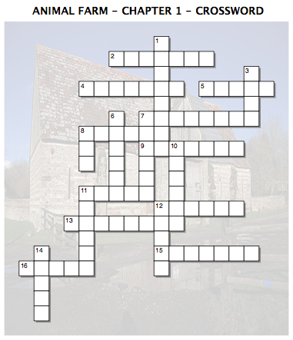
Across
2. Adjective used to describe Mollie.
4. One of the three dogs.
5. All animals are ___________.
7. The oldest animal on the farm.
8. The farm's white goat.
9. What animals are not allowed to drink.
11. The farm's raven.
12. One of the three dogs
13. Oldest and wisest of the pigs.
15. Country in which the animals live.
16. Where animals are not allowed to live.
Down
1. One of the three dogs.
3. Where the meeting was held.
6. What Jones does with his old dogs.
7. ____________ of England - Song taught to the animals.
8. Who Old Major blames for the animals problems.
10. The female cart horse.
11. The farm's white mare.
12. Mr ___________ - The owner of Manor Farm
14. The strongest of all the animals.

Slide 5
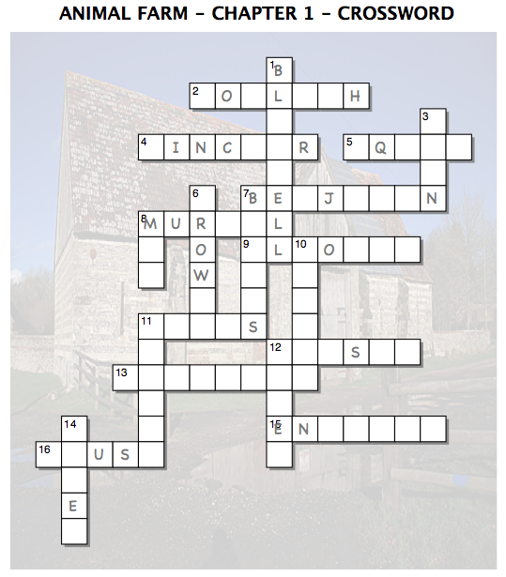
Across
2. Adjective used to describe Mollie.
4. One of the three dogs.
5. All animals are ___________.
7. The oldest animal on the farm.
8. The farm's white goat.
9. What animals are not allowed to drink.
11. The farm's raven.
12. One of the three dogs
13. Oldest and wisest of the pigs.
15. Country in which the animals live.
16. Where animals are not allowed to live.
Down
1. One of the three dogs.
3. Where the meeting was held.
6. What Jones does with his old dogs.
7. ____________ of England - Song taught to the animals.
8. Who Old Major blames for the animals problems.
10. The female cart horse.
11. The farm's white mare.
12. Mr ___________ - The owner of Manor Farm
14. The strongest of all the animals.

